Slide 1

Functions ,Modules & Packages

Slide 2

Manishkumar R Solanki
Sr. Lecturer, Information Technology,
manish_ratilal2002@yahoo.com
SBMP

Slide 3
Students will be able to:
Develop user defined functions
Use in-built functions effectively (as per requirements)

Slide 4
Developing user defined functions in Python

Slide 5
Function
A function is a piece of code written to carry out a specific task.
It is self contained and can be called repetitively when needed.
A function may take zero or more inputs and can return zero, one or more values.
# There are 3 types of functions in Python:
Built-in(Library Functions): i.e. print(),help(), type(), id(), min(), etc.
User –Defined Functions: Developed by users as per requirements using def keyword
Anonymous functions: Also called lambda functions because they are not declared with the standard def keyword

Slide 6
A method refers to a function which is part of a class. You access it with an instance or object of the class.
A function doesn’t have this restriction: it just refers to a standalone function.
All methods are functions, but not all functions are methods.

Slide 7
Defining a Function
Python provides the def keyword to define the function.
Syntax:
def my_function(parameters):
function_block
return expression
# Function Calling
my_function()

Slide 8
Defining a Function
Example:
Syntax:
def hello():
print(“Hello Function”)
# Function Calling
hello()
Output:
Hello Function

Slide 9
Function with argument
Example1:
def func (name):
print("Hi ",name)
#calling the function
func(“Rakesh")
Example2:
def add(a,b):
c=a+b
print("The addition of ",a, " and ",b,"=",c)
#Function call
add(2,3)

Slide 10
Function with return value
Example:
def add(a,b):
c=a+b
return (c)
#Function call
print("Enter 2 numbers")
x=int(input())
y=int(input())
z=add(x,y)
print("The addition of ",x, " and ",y,"=",z)
Enter 2 numbers
2
6
The addition of 2 and 6 = 8

Slide 11
#Parameters are the names used when defining a function or a method, and into which arguments will be mapped.
#Arguments are the things which are supplied to any function or method at the time of call.

Slide 12
We can use return statement to simply leave the function in between.

Slide 13
Function with multiple return values
We can return multiple values from a function using a tuple.
# Define 'swap()'
def swap(a,b):
x=a
a=b
b=x
return (a,b)
# Call swap() function
a=5
b=2
print("Before Swap a=",a,"b=",b)
a, b = swap(a,b)
print("After Swap a=",a,"b=",b)
Before Swap a= 5 b= 2
After Swap a= 2 b= 5
Note: The return statement return a, b or return (a, b) actually packs a and b into a tuple under the hood.

Slide 14
Performing operation on returned value
def hello():
print("Hello World")
return("hello")
def hello_noreturn():
print("Hello World")
# Multiply the output of 'hello()' with 2
hello() * 2
# (Try to) multiply the output of 'hello_noreturn()' with 2
hello_noreturn() * 2
A TypeError that says that you can’t do the multiplication operation for NoneType (the None that is the result of hello_noreturn()) and int (2).

Slide 15
Function with default arguments
Python allows us to initialize the arguments in the function definition.
If the value of any of the arguments is not provided at the time of function call, then that argument can be initialized with the value given in the definition.
def simplei(p,n,r=4):
si=p*n*r/100
return (si)
#Function call
print("Enter principal amount and no. of years:")
p=int(input())
n=int(input())
#passing interest rate
print("The simple interest=",simplei(p,n,5))
#without passing interest rate
print("The simple interest=",simplei(p,n))
Enter principal amount and no. of years:
3000
4
The simple interest= 600.0
The simple interest= 480.0

Slide 16
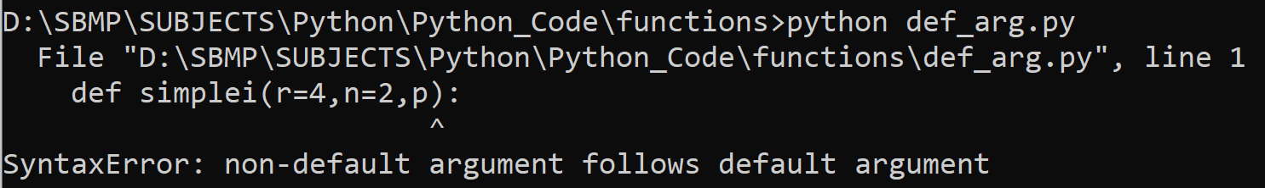
Default parameters should be written from Right to Left not from Left to Right.

Slide 17
Function with keyword arguments
# Define 'add()'
def add(a,b):
return (a+b)
# Call add() function
print(add(1,2))
print(add(b=2,a=1))
3
3

Slide 18
Function with variable arguments
In cases where we don’t know the exact number of arguments to pass to a function, we can use the variable arguments.
It is denoted with * followed by variable name.
# var args
def add(*args):
#print(type(args))
total = 0
for i in args:
total += i
return total
# Calculate the sum
print(add(10,20,40,50))
120
Note: We can use in-built function sum() also i.e. sum(args)
Here, the type of args is tuple

Slide 19
Function with **kwargs
Python provides the facility to pass the multiple keyword arguments which can be represented as **kwargs.
It is similar as the *args but it stores the argument in the dictionary format.
def food(**kwargs):
print(kwargs)
food(a="Apple")
food(fruits="Orange", Vegetables="Carrot")
{'a': 'Apple'}
{'fruits': 'Orange', ‘Vegetables': 'Carrot'}

Slide 20
Doc Strings
Docstrings describe what your function does, such as the computations it performs or its return values.
Serves documentation for your function so that anyone who reads your function’s docstring understands what your function does.
Function docstrings are placed in the immediate line after the function header and are placed in between triple quotation marks.
def hello():
"""Prints "Hello World".
Returns:
None
"""
print("Hello World")

Slide 21
Built in functions in Python

Slide 22
any()
The any() function checks for any element in the iterable and if present then returns True otherwise returns False.
print(any([1,]))
print(any((1,)))
print(any({1:1}))
print(any({}))
print(any(set()))
True
True
True
False
False
Note: Works with List, tuple, set and dictionary(values)

Slide 23
all()
The all() function returns True if all items in an iterable are true, otherwise it returns False.
True
True
False
mylist1 = [1, 1, 1]
x = all(mylist1)
print(x)
mylist2 = [True, True, True]
print(all(mylist2))
mylist3 = [0, 1, 1]
print(all(mylist3))
Note: Works with List, tuple, set and dictionary(values)

Slide 24
chr() & ord()
The chr() function returns a single character string represented by the integer value.
A
a
卍
😀
Output from google colab
print(chr(65))
print(chr(97))
print(chr(21325)) # swastika
print(chr(128512)) #Grinning Face
The ord() function (short of ordinal) returns an integer representing the character passed to it.
print(ord('A'))
print(ord("a"))
print(ord(" "))
65
97
32

Slide 25
filter()
The filter() method constructs an iterator from elements of an iterable for which a function returns true.
filter() method filters the given iterable with the help of a function that tests each element in the iterable to be true or not.
Syntax: filter(function, iterable)
#function - function that tests if elements of an iterable return true or false.
#iterable - iterable which is to be filtered, could be sets, lists, tuples, or containers of any iterators

Slide 26
filter()
def fun(variable):
#print(variable)
letters = ['a', 'e', 'i', 'o', 'u']
if (variable in letters):
return True
else:
return False
# sequence
sequence = ['P', 'y', 't', 'h', 'o', 'n','i','c']
# using filter function
filtered = filter(fun, sequence)
print(filtered)
print('The filtered letters are:')
for s in filtered:
print(s)
<filter object at 0x000001BFC41A6FA0>
The filtered letters are:
o
i
Working: filter() method then passes each letter to the filter_vowels() function to check if it returns true or not. At the end, it creates an iterator of the ones that return true (vowels).
Note: when function is defined (element for element in iterable if function(element))

Slide 27
filter() without function
# filter without function
# random list
l1 = [1, 'a', 0, False, True, '0']
flist = filter(None, l1)
print('The filtered elements are:')
for e in flist:
print(e)
The filtered elements are:
1
a
True
0
Working: when function is None (element for element in iterable if element)

Slide 28
globals() & locals()
globals() and locals() returns the global and local symbols table respectively.
Python interpreter maintains a data structure containing information about each identifier appearing in the program's source code.
This information is about the type, value, scope level, and location of an identifier (symbol). The symbols may be variables, functions, and classes etc.
Python interpreter uses the dictionary object to hold this information.
num1=10
num2=20
name="symbols Demo"
def add(x,y):
z=x+y
print("Global Symbols-->",globals(),"\n")
print("Local Symbols-->",locals())
return z
add(2,5)

Slide 29
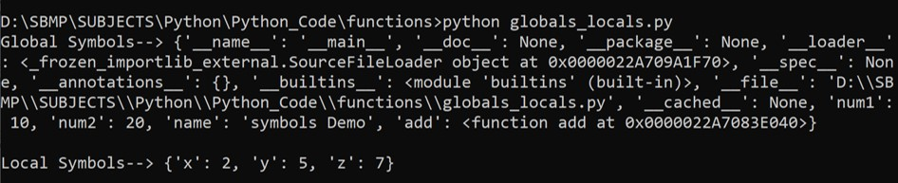
globals() & locals()

Slide 30
map()
map() loops over the items of an input iterable (or iterables) and returns an iterator that is result of a transformation function applied to every item in the original input iterable.
map() takes a function object and an iterable (or multiple iterables)
Syntax: map(function, iterable[, iterable1, iterable2,..., iterableN])
map() applies function to each item in iterable in a loop and returns a new iterator that yields transformed items on demand.
numbers = [1, 2, 3, 4, 5]
squared = []
for num in numbers:
squared.append(num ** 2)
print(squared)
def square(number):
return number ** 2
numbers = [1, 2, 3, 4, 5]
squared = map(square, numbers)
print(list(squared))
[1, 4, 9, 16, 25]

Slide 31
#In Python 2.x, map() returns a list.
#In Python 3.x., map() returns a map object, which is an iterator that yields items on demand. So, you need to call list() to create the desired list object.

Slide 32
map()
str_nums = ["6", "7", "8", "9"]
int_nums = map(int, str_nums)
print(list(int_nums))
numbers = [-4, -3, 0, 4, 3]
abs_values = list(map(abs, numbers))
print(abs_values)
print(list(map(float, numbers)))
words = ["Working", "of","Python","map()","function"]
print(list(map(len, words)))
[6, 7, 8, 9]
[4, 3, 0, 4, 3]
[-4.0, -3.0, 0.0, 4.0, 3.0]
[7, 2, 6, 5, 8]

Slide 33
map()
# Multiple iterables
first_it = [1, 2, 3]
second_it = [4, 5, 6]
print(list(map(pow, first_it, second_it)))
#String functions
str1 = ["applyting", "map", "on", "strings"]
print(list(map(str.capitalize, str1)))
print(list(map(str.upper, str1)))
print(list(map(str.lower, str1)))
[1, 32, 729]
['Applyting', 'Map', 'On', 'Strings']
['APPLYTING', 'MAP', 'ON', 'STRINGS']
['applyting', 'map', 'on', 'strings']

Slide 34
reduce()
Python’s reduce() implements a mathematical technique commonly known as folding or reduction.
It reduces a list of items to a single cumulative value. It operates on any iterable performs the following steps:
Working:
Apply a function (or callable) to the first two items in an iterable and generates a partial result.
Uses this partial result with the third item in the iterable, to generate another partial result.
Repeat the process until the iterable is exhausted and then return a single cumulative value.

Slide 35
reduce()
Syntax: functools.reduce(myfunction, iterable, initializer)
def my_add(a, b):
result = a + b
print(f"{a} + {b} = {result}")
return result
from functools import reduce
numbers = [0, 1, 2, 3, 4]
reduce(my_add, numbers)
0 + 1 = 1
1 + 2 = 3
3 + 3 = 6
6 + 4 = 10
100 + 0 = 100
100 + 1 = 101
101 + 2 = 103
103 + 3 = 106
106 + 4 = 110
110
print(reduce(my_add, numbers, 100))

Slide 36
reduce() was originally a built-in function (and still is in Python 2.x), but it was moved to functools. reduce() in Python 3.0. This decision was based on some possible performance and readability issues.

Slide 37
reduce()
#Factorial using reduce() function
import functools
def mult(x,y):
print("x=",x," y=",y)
return x*y
fact=reduce(mult, range(1, 5))
print ('Factorial of 4: ', fact)
x= 1 y= 2
x= 2 y= 3
x= 6 y= 4
Factorial of 4: 24

Slide 38
Working with Modules

Slide 39
Modules
Modular programming refers to the process of breaking a large, unwieldy programming task into separate, smaller, more manageable subtasks or modules. Individual modules can then be cobbled together like building blocks to create a larger application.
A module is a file (.py) containing Python definitions and statements.
It can define functions, classes, and variables.
It can also include runnable code.
Grouping related code into a module makes the code easier to understand and use. (code becomes logically organized)
Modules provide reusability of code.
We can define our most used functions in a module and import it, instead of copying their definitions into different programs.

Slide 40
Advantages of Modules
Simplicity: Rather than focusing on the entire problem, a module typically focuses on one relatively small portion of the problem.
Reusability: Functionality defined in a single module can be easily reused by other parts of the application. (eliminates code duplication)
Scoping: Modules typically define a separate namespace, which helps avoid collisions between identifiers in different areas of a program.
Maintainability: Modules minimize interdependency, that is modifications to a single module will not have an impact on other parts of the program. (We can make changes to a module without having any knowledge of the application outside that module.)

Slide 41
Modules
A module is written as a normal Python file i.e. calculation.py
def add(x,y):
return (x+y)
def sub(x,y):
return (x-y)
A module is imported using import statement i.e. import module_name
import calculation
print(calculation.add(2,5))
print(calculation.sub(6,2))
7
4

Slide 42
Modules
We can rename module while importing(Syntax): import module_name as mn
import calculation as cal
print(cal.add(2,5))
print(cal.sub(6,2))
Importing a specific function from a module:
from calculation import add
print(add(2,5))
from math import pi, e
print("Value of pi=",pi)
print("Value of e=",e)
Importing all functions from a module:
from calculation import *
print(add(2,5))
print(sub(6,2))
Value of pi= 3.141592653589793
Value of e= 2.718281828459045

Slide 43
We can use the dir() function to find out names that are defined inside a module.

Slide 44
The Module Search Path
When the interpreter executes the import statement, it searches for module name in a list of directories from the following sources:
The directory from which the input script was run or the current directory if the interpreter is being run interactively.
The list of directories contained in the PYTHONPATH environment variable, if it is set.
An installation-dependent list of directories configured at the time Python is installed.

Slide 45
The Module Search Path
Appending module path in sys inside the script.
import sys
my_path="D:\\SBMP\\SUBJECTS\\Python\\Python_Code\\modules"
if my_path not in sys.path:
sys.path.append(my_path)
from calculation import *
print(add(2,5))
print(sub(6,2))

Slide 46
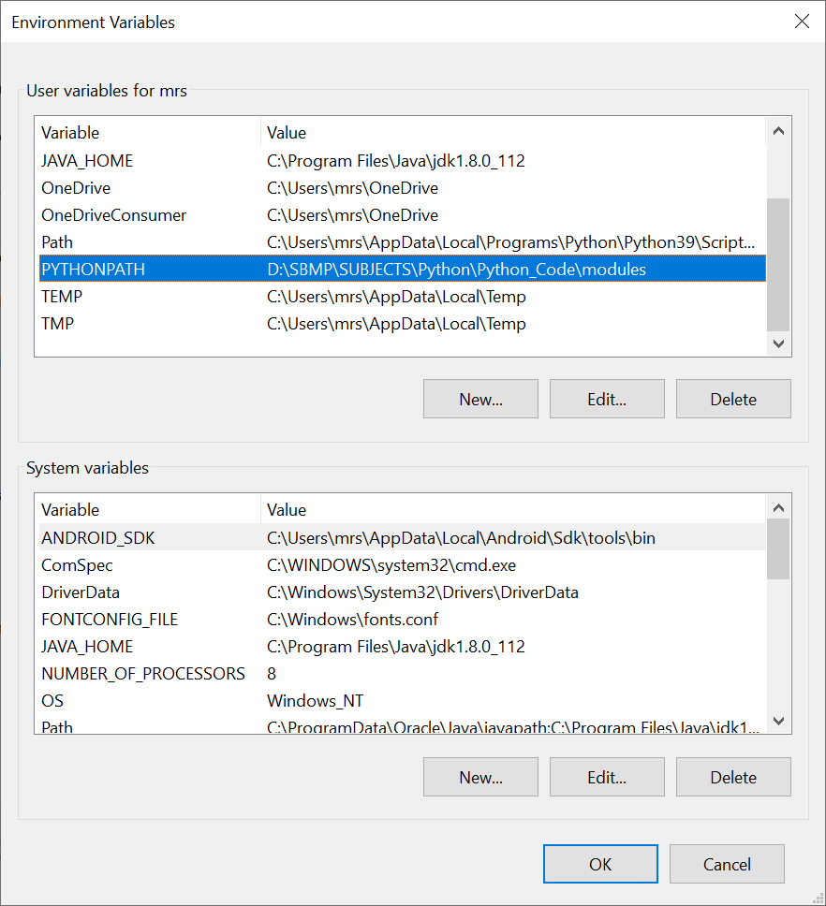
The Module Search Path
Creating PYTHONPATH environment variable.
from calculation import *
print(add(2,5))
print(sub(6,2))

Slide 47
Python in-built Modules

Slide 48
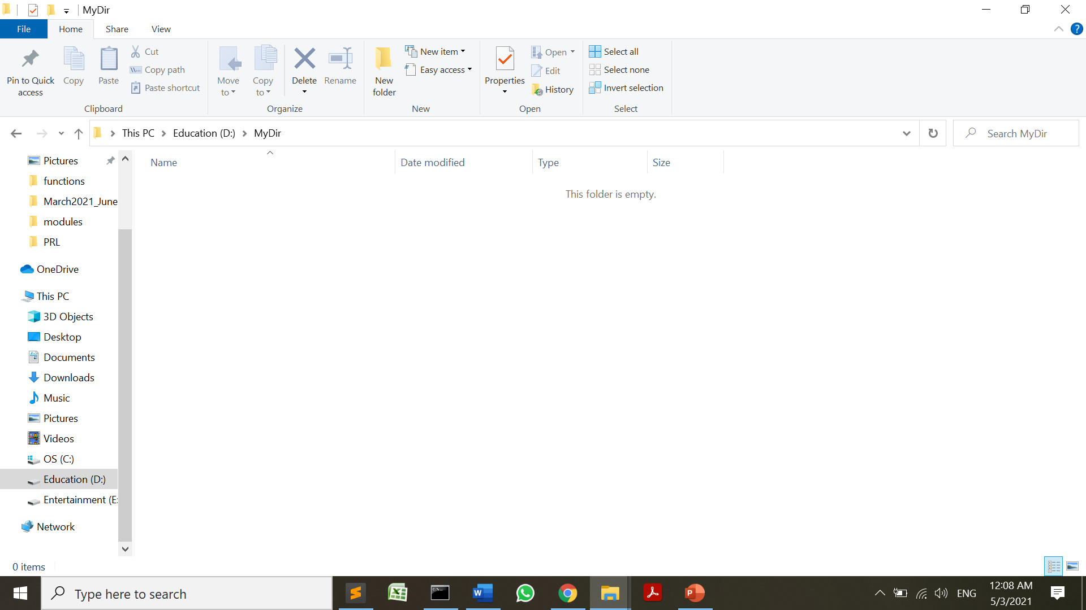
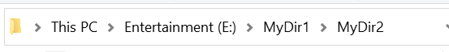
os Module
The OS module in Python provides functions for interacting with the operating system.
OS comes under Python’s standard utility modules and provides operating system-dependent functionality.
The *os* and *os.path* modules include many functions to interact with the file system.
D:\SBMP\SUBJECTS\Python\Python_Code\modules
d:\MyDir
import os
os.mkdir("d:\\MyDir")
print(os.getcwd())
os.chdir("d:\\MyDir")
print(os.getcwd())
os.makedirs("e:\\MyDir1\\MyDir2")
os.rmdir("d:\\MyDir")

Slide 49
random Module
The random module is used to generate the pseudo-random variables.
It can be used to perform some action randomly such as to get a random number, selecting a random elements from a list, shuffle elements randomly, etc.
import random
print("random floating value 0 to 1")
print(random.random())
#Generating random integers
print("random integers")
print(random.randint(1, 100))
#random element from range
print("random elements from range")
print(random.randrange(1, 10))
print(random.randrange(1, 10, 2))
print(random.randrange(0, 101, 10))
print(random.randrange(0, 101, 10))

Slide 50
random Module
#selecting random elements
print("Selecting random elements")
print(random.choice('calculator'))
print(random.choice([11,20,40,60,65,46]))
print(random.choice((11,20,40,60,65,46)))
#shuffling elements of a list randomly
print("shuffling list elements:")
numbers=[1,20,40,56,30,26]
random.shuffle(numbers)
print(numbers)
random.shuffle(numbers)
print(numbers)
random floating value 0 to 1
0.9702953580389522
random integers
80
random elements from range
2
1
40
40
Selecting random elements
l
11
65
shuffling list elements:
[40, 1, 26, 30, 20, 56]
[40, 1, 30, 20, 26, 56]

Slide 51
datetime Module
Python has a module named datetime to work with dates and times.
import datetime
dtob = datetime.datetime.now()
print(dtob)
#Get current date
tdate=datetime.date.today() # YYYY-MM-DD
print(tdate)
from datetime import date
date_from_ts = date.fromtimestamp(1326244364)
print("Date =", date_from_ts)
#year,month and day
today = date.today()
print("Current year:", today.year)
print("Current month:", today.month)
print("Current day:", today.day)
2021-05-03 00:47:45.438580
2021-05-03
Date = 2012-01-11
Current year: 2021
Current month: 5
Current day: 3

Slide 52
datetime Module
# time related operations
print("\nWorking with time")
from datetime import time
# time(hour = 0, minute = 0, second = 0)
a = time()
print("a =", a)
# time(hour, minute and second)
b = time(11, 34, 56)
print("b =", b)
# time(hour, minute and second)
c = time(hour = 11, minute = 34, second = 56)
print("c =", c)
# time(hour, minute, second, microsecond)
d = time(11, 34, 56, 234566)
print("d =", d)
print("\nworking with datetime")
from datetime import datetime
a = datetime(2017, 11, 28, 23, 55, 59, 342380)
print("year =", a.year)
print("month =", a.month)
print("hour =", a.hour)
print("minute =", a.minute)
print("timestamp =", a.timestamp())
Working with time
a = 00:00:00
b = 11:34:56
c = 11:34:56
d = 11:34:56.234566
working with datetime
year = 2017
month = 11
hour = 23
minute = 55
timestamp = 1511893559.34238

Slide 53
Format date using strftime()
from datetime import datetime
# current date and time
now = datetime.now()
t = now.strftime("%H:%M:%S")
print("time:", t)
s1 = now.strftime("%m/%d/%Y, %H:%M:%S")
# mm/dd/YY H:M:S format
print("s1:", s1)
s2 = now.strftime("%d/%m/%Y, %H:%M:%S")
# dd/mm/YY H:M:S format
print("s2:", s2)
time: 00:55:38
s1: 05/03/2021, 00:55:38
s2: 03/05/2021, 00:55:38

Slide 54
Format date using string
The strptime() method creates a datetime object from a given string (representing date and time).
date_string = "21 June, 2018"
print("date_string =", date_string)
date_object = datetime.strptime(date_string, "%d %B, %Y")
print("date_object =", date_object)
date_string = 21 June, 2018
date_object = 2018-06-21 00:00:00

Slide 55
Time Zone
from datetime import datetime
import pytz #third party module
local = datetime.now()
print("Local:", local.strftime("%m/%d/%Y, %H:%M:%S"))
tz_NY = pytz.timezone('America/New_York')
datetime_NY = datetime.now(tz_NY)
print("NY:", datetime_NY.strftime("%m/%d/%Y, %H:%M:%S"))
tz_London = pytz.timezone('Europe/London')
datetime_London = datetime.now(tz_London)
print("London:", datetime_London.strftime("%m/%d/%Y, %H:%M:%S"))
Local: 05/03/2021, 01:02:30
NY: 05/02/2021, 15:32:31
London: 05/02/2021, 20:32:31

Slide 56
calendar Module
Python defines an inbuilt module calendar which handles operations related to calendar
By default, these calendars have Monday as the first day of the week, and Sunday as the last (the European convention).
calendar(year, w, l, c) :- This function displays the year, width between 2 columns, blank line between 2 rows and Space between two months
firstweekday() :- This function returns the first week day number. By default 0 (Monday).

Slide 57
calendar Module
Python defines an inbuilt module calendar which handles operations related to calendar
By default, these calendars have Monday as the first day of the week, and Sunday as the last (the European convention).
May 2021
Mo Tu We Th Fr Sa Su
1 2
3 4 5 6 7 8 9
10 11 12 13 14 15 16
17 18 19 20 21 22 23
24 25 26 27 28 29 30
31
import calendar
yy = 2021
mm = 5
# display the calendar
print(calendar.month(yy, mm))
print ("The calender of year 2021 is : ")
print (calendar.calendar(2021, 2, 1, 6))

Slide 58
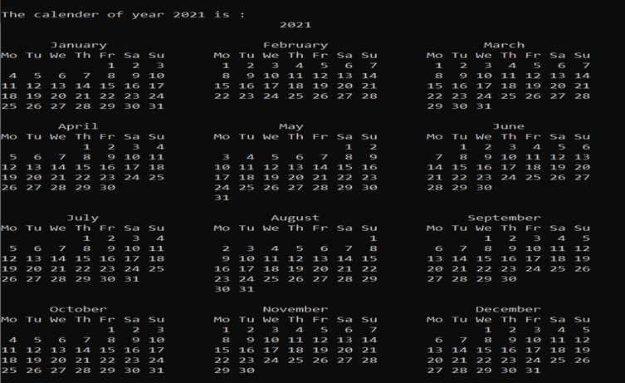
calendar Module

Slide 59
sys Module
The sys module provides functions and variables used to manipulate different parts of the Python runtime environment.
sys.argv returns a list of command line arguments passed to a Python script. The item at index 0 in this list is always the name of the script. The rest of the arguments are stored at the subsequent indices.
import sys
print("You entered: ",sys.argv[1], sys.argv[2], sys.argv[3])
D:\SBMP\SUBJECTS\Python\Python_Code\modules>python sys_mod.py 1 2 3
You entered: 1 2 3

Slide 60
sys Module
sys.exit: Causes the script to exit back to either the Python console or the command prompt.
sys.maxsize: Returns the largest integer a variable can take.
sys.path: This is an environment variable that is a search path for all Python modules.
sys.version : This attribute displays a string containing the version number of the current Python interpreter.
sys.platform : This value of this function is used to identify the platform on which we are working.

Slide 61
sys Module
9223372036854775807
['D:\\SBMP\\SUBJECTS\\Python\\Python_Code\\modules', 'D:\\SBMP\\SUBJECTS\\Python\\Python_Code\\modules', 'C:\\Users\\mrs\\AppData\\Local\\Programs\\Python\\Python39\\python39.zip', 'C:\\Users\\mrs\\AppData\\Local\\Programs\\Python\\Python39\\DLLs', 'C:\\Users\\mrs\\AppData\\Local\\Programs\\Python\\Python39\\lib', 'C:\\Users\\mrs\\AppData\\Local\\Programs\\Python\\Python39', 'C:\\Users\\mrs\\AppData\\Local\\Programs\\Python\\Python39\\lib\\site-packages']
3.9.0 (tags/v3.9.0:9cf6752, Oct 5 2020, 15:34:40) [MSC v.1927 64 bit (AMD64)]
win32
import sys
print(sys.maxsize)
print(sys.path)
print(sys.version)
print(sys.platform)

Slide 62
Working with Anonymous Functions in Python

Slide 63
Anonymous(Lambda) Functions
In Python, an anonymous function is a function that is defined without a name.
Anonymous functions are defined using the lambda keyword. Hence, they are also called lambda functions.
Syntax: lambda arguments: expression
#Lambda functions can have any number of arguments but only one expression. The expression is evaluated and returned.
#Lambda functions can be used wherever function objects are required.

Slide 64
Anonymous(Lambda) Functions
Example:
twice = lambda x: x * 2
print(twice(5))
10
def twice(x):
return x * 2
x = lambda a, b : a * b
print(x(5, 6))
30

Slide 65
Anonymous(Lambda) Functions
Example with filter function:
# Program to filter out only +ve numbers from a list
my_list = [1, -5, 9, -6, -8, 0, 3, 15]
pos_list = list(filter(lambda x: (x>0) , my_list))
print(pos_list)
[1, 9, 3, 15]
# Program to square each item in a list using map()
my_list2 = [1,3,5,7,9]
sq_list = list(map(lambda x: x ** 2 , my_list2))
print(sq_list)
[1, 9, 25, 49, 81]

Slide 66
Anonymous(Lambda) Functions
cities = ['mumbai', 'pune', 'rajkot', 'baroda']
uppered_cities = list(map(lambda city: str.upper(city), cities))
print(uppered_cities)
from functools import reduce
li = [5, 8, 1, 2, 7, 10]
sum = reduce((lambda x, y: x + y), li)
print (sum)
['MUMBAI', 'PUNE', 'RAJKOT', 'BARODA']
33
import functools
# initializing list
lis = [ 1,3, 7, 8, 10]
# using reduce to compute maximum element from list
print ("The maximum element of the list is : ",end="")
print (functools.reduce(lambda a,b : a if a > b else b,lis))
The maximum element of the list is : 10

Slide 67
On Python Shell We can write:
>>(lambda x, y: x + y)(2, 3)
5

Slide 68
Working with Packages in Python

Slide 69
Packages
Packages are a way of structuring many packages and modules which helps in a well-organized hierarchy of data set.
Like different drives and folders in an OS to help us store files, packages help us in storing other sub-packages and modules.
A package can contain modules, sub-modules, function, classes
To create a package in Python, we need to follow these three simple steps:
First, we create a directory and give it a package name, preferably related to its operation.
Then we put the classes and the required functions in it.
Finally, we create an __init__.py file inside the directory, to let Python know that the directory is a package.

Slide 70
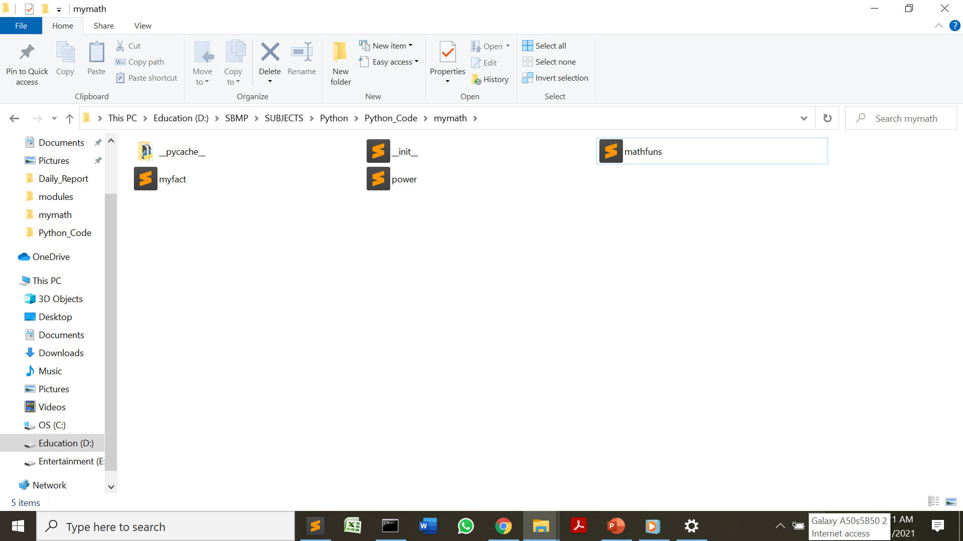
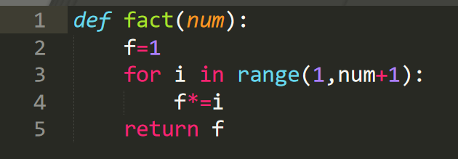
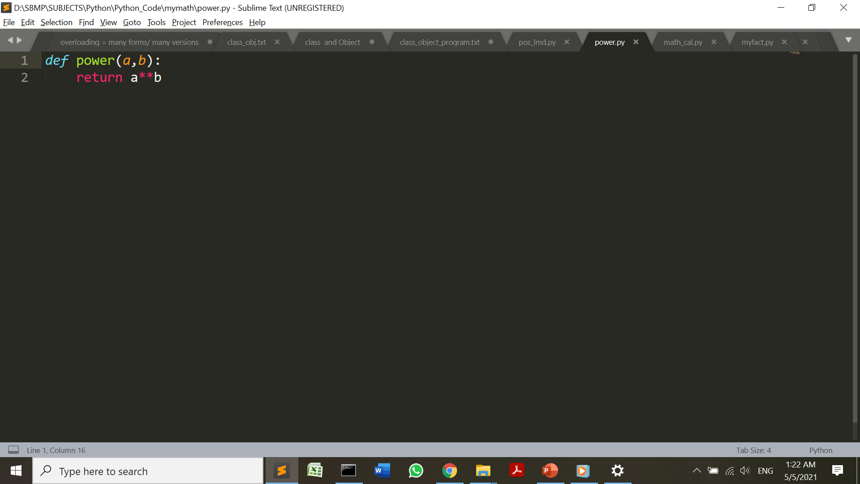
Packages
Example: Create a folder i.e. mymath and create some module files as shown in the below diagrams:

Slide 71
Add mymath folder path into PYTHONPATH environment variable

Slide 72
Packages
Example: Now import the package and required module as shown below:
from mymath import myfact
print(myfact.fact(3))
from mymath import power
print(power.power(2,3))
from mymath.power import *
print(power(2,3))
6
8
8

Slide 73
We can go for parent-child hierarchy of directories for packages. (like Java) You can practice the following example after getting exposure of class concept in Python.
https://www.geeksforgeeks.org/create-access-python-package/

Slide 74
References
https://www.tutorialsteacher.com/articles/globals-and-locals-in-python
https://realpython.com/python-map-function
https://www.programiz.com/python-programming/datetime
https://www.tutorialsteacher.com/python/sys-module
https://www.geeksforgeeks.org/python-lambda-anonymous-functions-filter-map-reduce/
https://www.geeksforgeeks.org/calendar-functions-in-python-set-1-calendar-month-isleap/
https://www.guru99.com/calendar-in-python.html

Slide 75
THANKS!
Any questions?
You can find me at
manish_ratilal2002@yahoo.com

